Slide 1

Heart Failure
Prepared By
Dr. Ahmed M. Abdel-Salam
MD cardiology, Ain Shams University

Slide 2
Indented Learning Outcomes (ILOs)
By the end of this lecture the student will be able to:
Definition and types of heart failure.
Pathogenesis of different types of heart failure.
Risk factors of heart failure.
Stages of heart failure.
Symptoms and signs of heart failure.
Complication of heart failure.
Evaluation of heart failure.
Treatment of heart failure.
Prognosis of heart failure

Slide 3
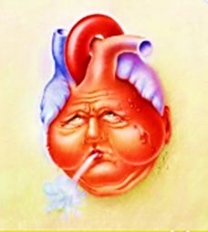
Definition:
It is the pathophysiological process in which the heart as a pump is unable to meet the metabolic requirements of the tissue for oxygen and substrates despite the venous return to heart is either normal or increased.
Heart failure is a clinical syndrome…… Can result from any structural or functional disorder that impairs stability of ventricle to fill with or eject blood.

Slide 4
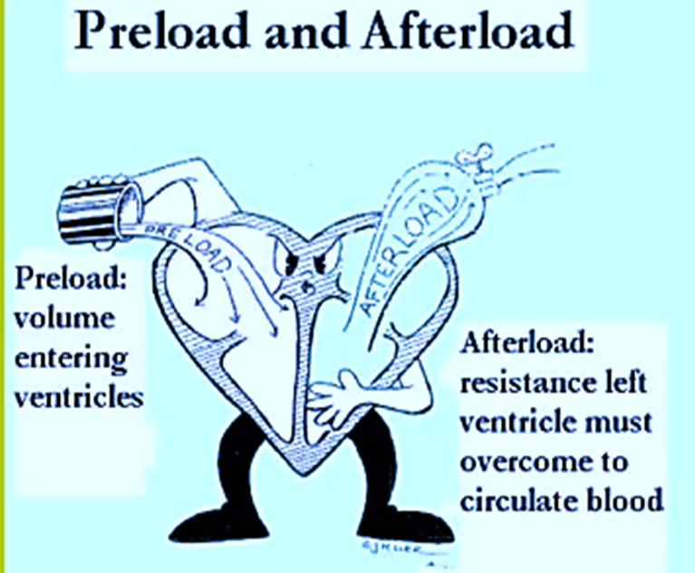
Factors Affecting heart pump effectiveness:
Preload:
Volume of blood in ventricles at end diastole.
Depends on venous return & Compliance.
Afterload:
Force needed to eject blood into circulation.
Depends on arterial BP, pulmonary artery pressure.
Valvular disease may increase the afterload

Slide 5
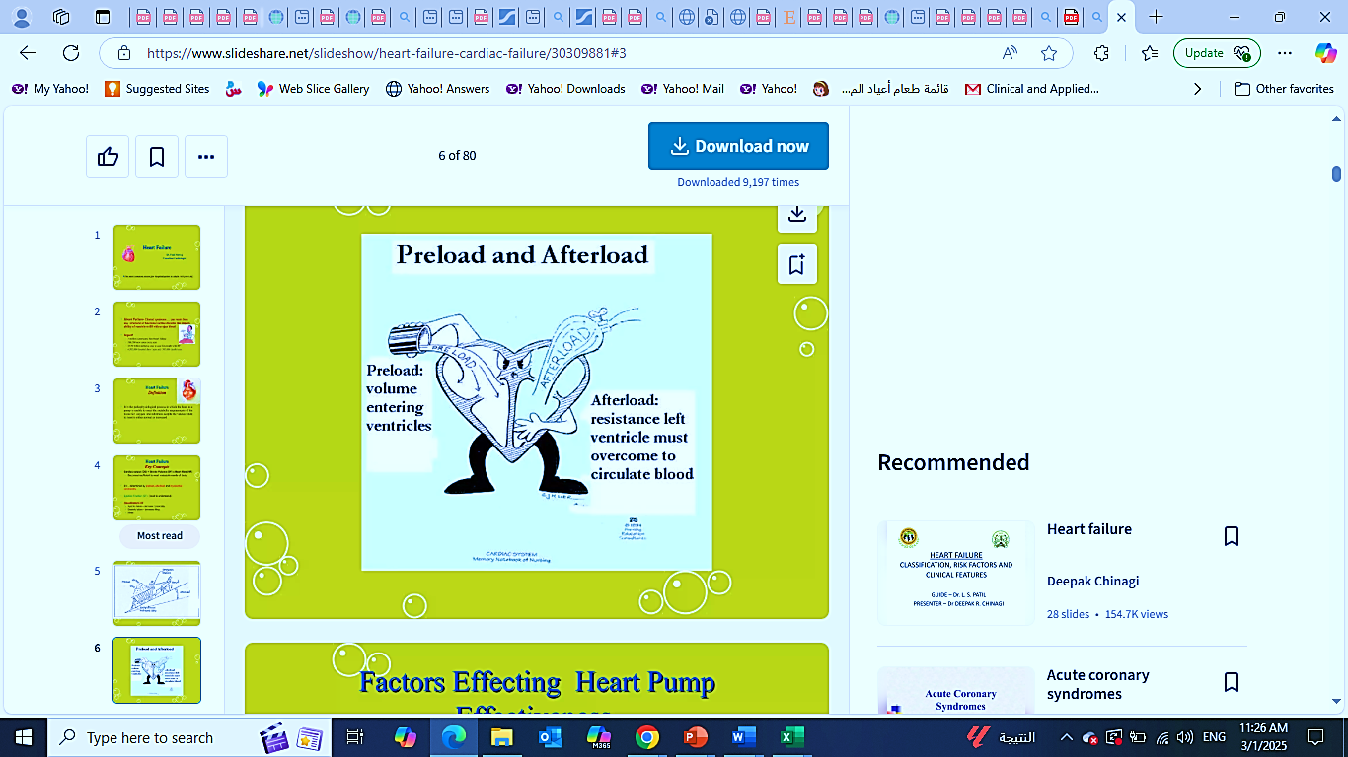
Classification:
Systolic Failure: Decrease contractility.
Diastolic failure: Decrease filling.
Mixed

Slide 6
Ejection fraction (EF%):
One of the measurements used by physician to assess how well a patient's heart is functioning.
“Ejection” refers to the amount of blood that is pumped out of the heart main out-pumping chamber during each heart beat.
“Fraction” refers to the fact that even in a healthy heart, some blood always remains within the chamber after each heart beat.
An ejection fraction is a percentage of the blood within the chamber that is pumped out with every heart beat.
Normal EF%: 55 to 75%.

Slide 7
Key to understand HF
When heart begins to fail/weakened (Unable to pump blood forward fluid backup increase pressure within all organ.
Organ response:
Lungs:
Congested
Increased effort to breathe.
Fluids starts to escape into alveoli (pulmonary edema)
Fluid interferes with O2 exchange (hypoxia)
Aggravates shortness of breath
SOB during exertion, may be early symptoms , progress
Later require extra pillows at night to breath (orthopnea)
Experience paroxysmal nocturnal dyspnea (PND).

Slide 8
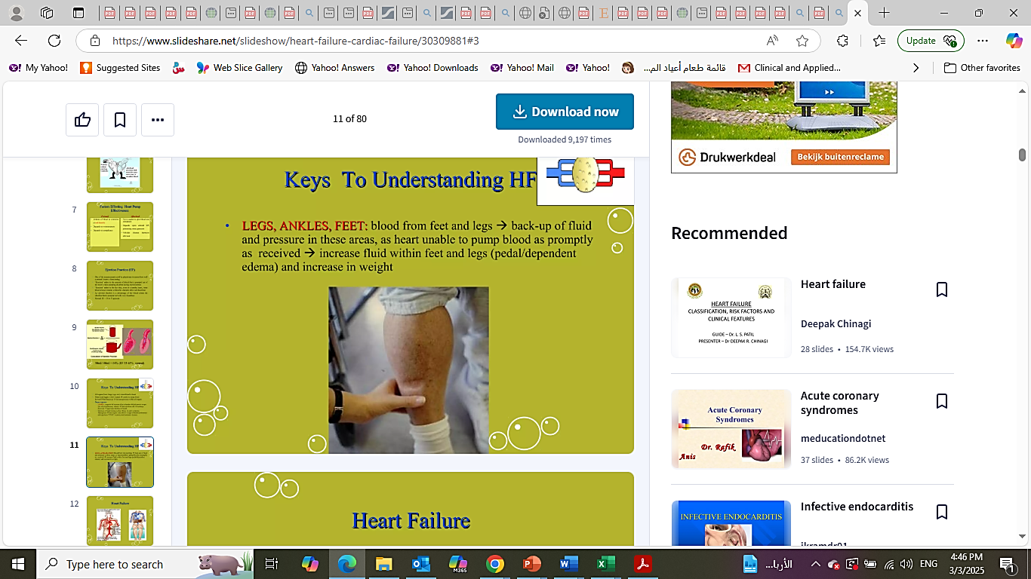
Key to understand HF
Organ response:
Legs, Ankles & Feet:
Blood from feet & Legs
Backup of fluid and pressure in these areas, as heart unable to pump blood as promptly as received.
Increase fluid within feet and legs (pedal dependent edema) & increase in weight

Slide 9
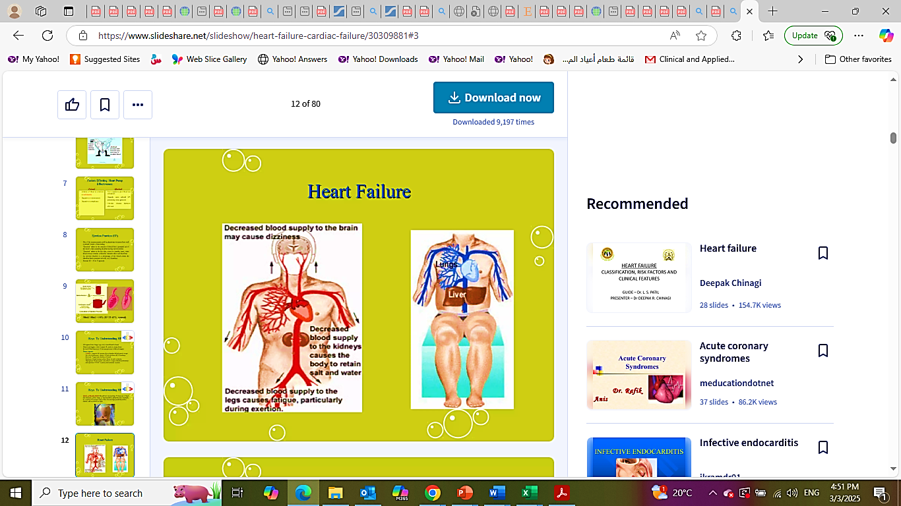
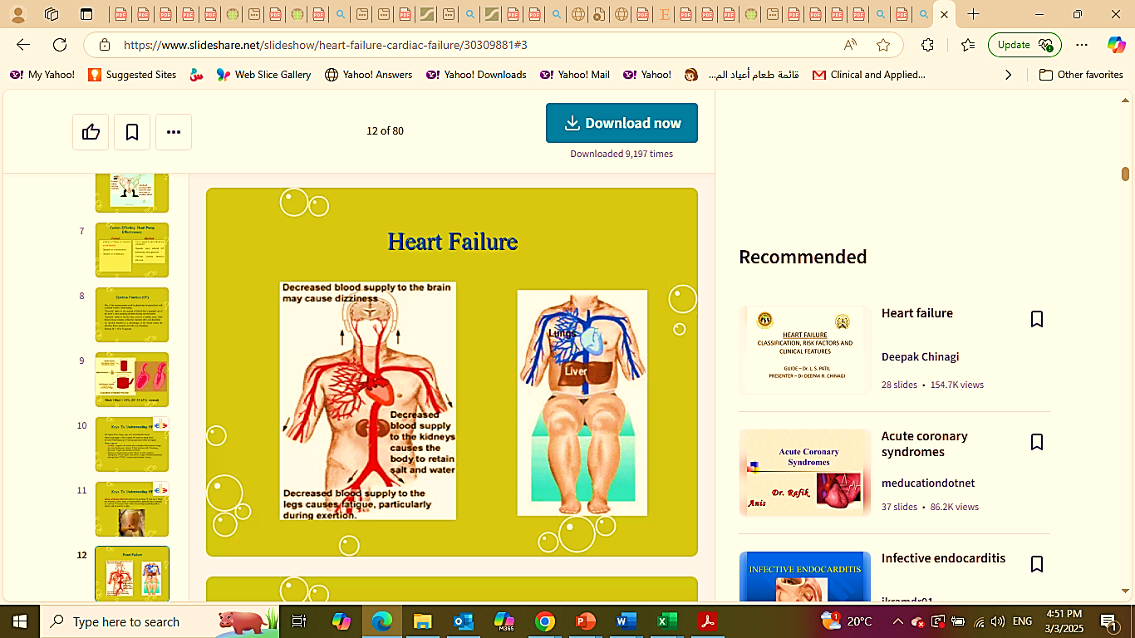
Key to understand HF
Organ response:

Slide 10
Etiology
Systolic Failure (Most common):
Hallmark finding: Decrease in left ventricular EF < 40% due to:
Impaired contractile function (e.g. MI)
Increase afterload (e.g. Hypertension).
Cardiomyopathy.
Mechanical abnormalities (e.g. valve disease)
Diastolic Failure (Normal EF%)
Impaired ability of ventricles to relax and fill during diastole leading to decrease SV & COP.
Diagnosis based on the presence of pulmonary congestion, pulmonary hypertension and ventricular hypertrophy

Slide 11
Etiology
Mixed Systolic & diastolic failure
Seen in disease states such as dilated cardiomyopathy (DCM).
Poor Ef (< 35%).
High pulmonary pressures
Biventricular failure:
Both ventricles may be dilated and have poor filling and emptying capacity.

Slide 12
Etiology
Mixed Systolic & diastolic failure
Seen in disease states such as dilated cardiomyopathy (DCM).
Poor Ef (< 35%).
High pulmonary pressures
Biventricular failure:
Both ventricles may be dilated and have poor filling and emptying capacity.

Slide 13
Pathophysiology
A. Cardiac Compansatory Mechanisms
Tachycardia.
Ventricular dilatation “Frank Starling’s Law”
Myocardial hypertrophy.
B. Homeostatic Compansatory Mechanismss:
Activation of the Sympathetic nervous system (First Line)
In the vascular system resulting in vasoconstriction; increasing afterload.
Kidneys:
Decrease renal perfusion leading to release of RAS system.
Aldosterone release leadingg to salt & water retention.
Liver:
Stores venous volume causing ascites & hepatomegaly

Slide 14
Pathophysiology
Counter Regulatory Response
Increase Na++: Release of antidiuretic hormone (ADH).
Release of atrial natriuretic factor (ANP) and BNP: Salt and water excretion. Thus, preventing severe cardiac decompensation.
Neurohormonal response:
Endothelin stimulated by ADH, Catecholamines and angiotensin II leading to:
Arterial vasoconstriction.
Increase in cardiac contractility.
Hypertrophy.
Proinflammatory cytokines (e.g. tumor necrosis factor) leading to:
Depress myocardial function leading to myocardial dysfunction and myocardial cell death.

Slide 15
Pathophysiology
Counter Regulatory Response
Natriuretic peptides:
Atrial natriuretic peptide (ANP), b-type natriuretic peptide (BNP).
Released in response to increase in atrial volume and ventricular pressure.
Promote venous and arterial vasodilatation, reduce preload and afterload.
Prolongation of heart failure leading to depletion of these factors.

Slide 16
Pathophysiology
Counter Regulatory Response
Ventricular dilation:
Frank – Starling Law:
Hypertrophy:
Elevated left ventricular pressure
Increase venous return
Chronic dilatation
Enlargement of cardiac chambers
Increase force of contraction
Increase muscle mass and cardiac wall thickness
More stretch of myocardium
Initially effective adaptive mechanism
Increase in O2 demand
More dilatation
More dilatation
Demand supply mismatch due to poor coronary supply
Failure of adaptive mechanisms
Failure of adaptive mechanisms
Ineffective contracrion
Poor contractility & prone to ventricular dysrhythmia
Decreased COP

Slide 17
Pathophysiology
Heart Failure
Decreased Cardiac Output
Activation of the Sympathetic nervous system
Decreased renal blood flow
Increased heart rate
RAAS system activation
Arterial & venous vasoconstriction
And
Salt & water retention
Stretching of the myocardium
Ventricular hypertrophy

Slide 18
Heart Failure Classification System
New York Heart Association Classification
Class | Patient Symptoms
Class I (Mild) | No Limitation of the physical activity. Ordinary physical activity does not cause undue fatigue, palpitation or shortness of breath.
Class II (Mild) | Slight Limitation of the physical activity. Comfortable at rest, but ordinary physical activity results in fatigue, palpitation or shortness of breath.
Class III (Moderate) | Marked Limitation of the physical activity. Comfortable at rest, but less than ordinary physical activity results in fatigue, palpitation or shortness of breath.
Class IV (Severe) | Unable to carry out any physical activity without discomfort. Symptoms of fatigue, palpitation or shortness of breath are present. If any physical activity is undertaken, discomfort increases.

Slide 19
Heart Failure Risk Factors
Primary risk factors:
Coronary artery disease (CAD).
Advancing age.
Contributing risk factors:
Hypertension.
Diabetes.
Tobacco use.
Obesity.
Dyslipidemia.
African American descent.
Valvular heart disease.
Hypervolemia

Slide 20
Heart Failure Causes
Impaired cardiac function:
Coronary heart disease.
Cardiomyopathy.
Rheumatic fever.
Endocarditis.
Increased cardiac workload
Hypertension.
Valvular disorders.
Anemias.
Congenital heart defects.
Acute non-cardiac conditions
Volume overload.
Hyperthyroid, fever, infection.

Slide 21
Heart Failure Causes
Systolic versus Diastolic
Systolic: Loss of contractility get decrease COP
Diastolic: Decreased filling or preload.
Left sided versus Right sided
Left ventricle: Lungs
Right ventricle: peripheral.
High output versus low output
Hypermetabolic state
Acute versus Chronic
Acute MI.
Chronic cardiomyopathy

Slide 22
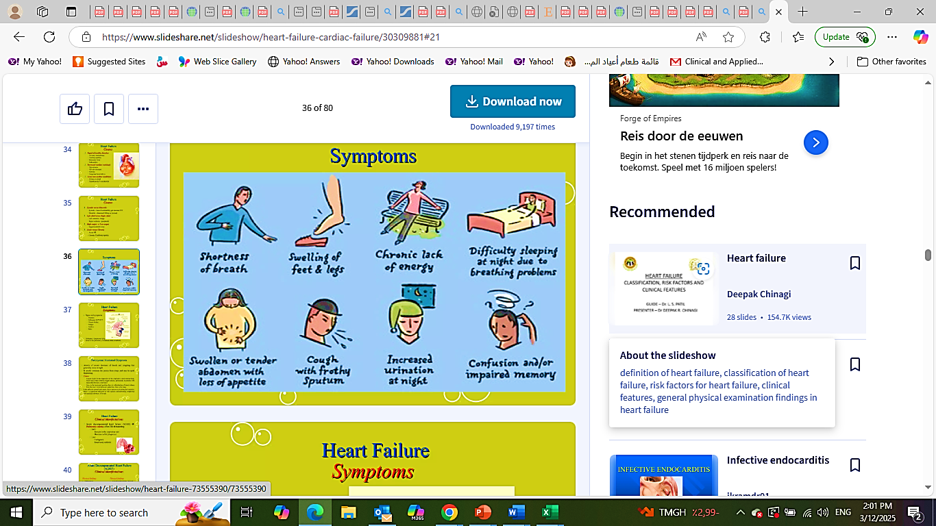
Heart Failure Symptoms

Slide 23
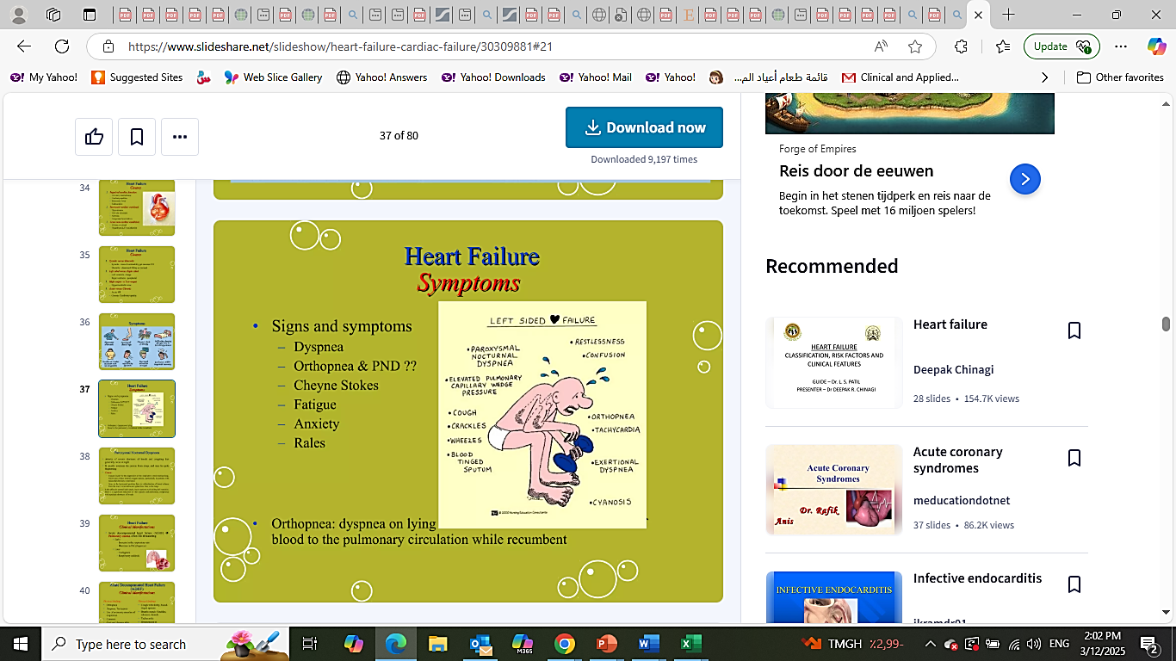
Heart Failure Symptoms
Signs and symptoms:
Dyspnea.
Orthopnea & PND ??.
Cheyne stokes.
Fatigue
Anxiety.
Rales.
Orthopnea:
Dyspnea on lying
blood to the pulmonary circulation while recumbent

Slide 24
Heart Failure Symptoms
Paroxysmal Nocturnal Dyspnea
Attacks of severe shortness of breath and coughing that generally occurs at night.
It usually awakens the person from sleep, and may be quite frightening.
Cause:
Depression of the respiratory center during sleep, which may reduce arterial oxygen tension, particularly in patients with reduced pulmonary compliance.
Redistribution of blood volume from the lower extremities and splanchnic beds to the lungs.
Little effect in normal individuals, but in patient with failing left ventricle, there is a significant reduction in vital capacity and pulmonary compliance with resultant shortness of breath.

Slide 25
Acute Decompensated H.F
Clinical manifestation
Physical Findings
Physical Findings
Orthopnea.
Dyspnea & Tachypnea.
Use of accessory respiratory muscles.
Cyanosis.
Cool and clammy skin.
S3 gallop rhythm.
Cough with frothy, blood-tinged sputum.
Breath sounds: Crackles, wheezes, rhonchi.
Tachycardia.
Hypotension or hypertension.

Slide 26
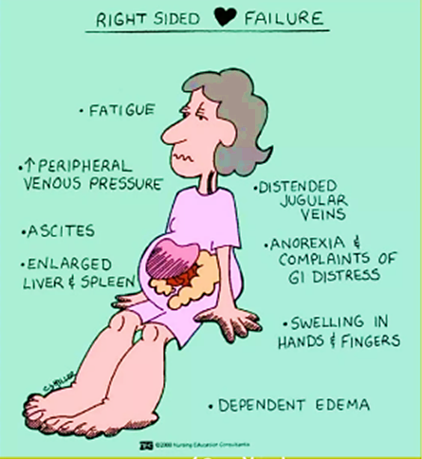
Right Heart Failure
Signs & Symptoms
Fatigue, weakness, lethargy.
Weight gain.
Increase abdominal girth.
Anorexia.
Rt. Upper quadrant pain.
Elevated neck veins.
Hepatomegaly.

Slide 27
Heart Failure
Complications
Pleural effusion.
Atrial fibrillation (most common dysrhythmia).
High risk of fatal dysrhythmias (e.g. sudden cardiac death, ventricular tachycardia) with HF and EF < 35%.
Severe Hepatomegaly especially with RV failure. This will lead to fibrosis and cirrhosis (cardiac cirrhosis).
Renal insufficiency and failure (Cardio – renal syndrome).

Slide 28
Heart Failure
Initial Evaluation
Primary Goal: Determine underlying cause
Thorough history and physical examination to identify cardiac and non cardiac disorders or behaviors that might cause or accelerate the development or prognosis of HF.
Volume status and vital signs should be assessed.

Slide 29
Heart Failure
Diagnostic Tests
Initial Lab workup includes
ECG.
Chest X – ray.
Complete blood count (CBC).
Urine analysis.
Serum electrolytes.
Serum creatinine & BUN.
Glucose.
Fasting Lipid profile.
Liver function tests.
Thyroid stimulating hormone.
Cardiac troponins.
BNP.
Arterial blood gas (ABG).

Slide 30
Heart Failure
Managment
Treatment of underlying risk factors
Adequate BP control.
Adequate Diabetes control.
Weight reduction.
Quit smoking.
Avoid cardiotoxins.
Lipid management
Atrial fibrillation management.

Slide 31
Heart Failure
Managment
Non pharmacological treatment
Life style changes: Low salt, low fat, rich in fruits & vegetables, increase fibers, water intake limited to 1.5 liters.
Smoking cessation.
Regular exercise.
Control of risk factors: HTN, DM & Lipid.

Slide 32
Heart Failure
Managment
Pharmacological treatment
Diuretics:
Frusemide (20 – 40mg once or twice).
Hydrochlorothiazide (25mg once or twice).
Metolazone (2.5 – 5 mg OD).
Spironolactone (12.5 – 25 once or twice).
Aim of diuretic therapy on outpatient is to decrease weight 0.5 to 1 Kg. daily with adequate diuresis and adjust the dose accordingly until evidence of fluid retention resolved.

Slide 33
Heart Failure
Managment
Pharmacological treatment
ACE inhibitors:
Captopril (6.25mg TID till 50 mg TID).
Enalapril (2.5 mg BID to 20 mg BID).
Lisinopril: (2.5 mg once to 40 mg once daily).
Ramipril: 1.25 – 2.5 mg once till 10 mg once daily).
Start with low dose with gradual increase to the max. tolerated dose.
Monitor renal function every 1 – 2 weeks.
C/I: Cr. > 3mg/dl, pregnancy, hypotension, SBP < 80mmHg, Hyperkalemia > 5mg/dl.
ACE induced cough (20%).

Slide 34
Heart Failure
Managment
Pharmacological treatment
Angiotensin receptor blockers:
When ACEI intolerant or alternative to ACEI.
AT – 1 receptor blocker.
Can be substituted to ACEI with angioedema history but with caution.
Losartan (25 – 50 mg once till 150 mg once daily).
Valsartan (20 – 40 mg twice daily till 160 mg BID).
Same initiation and monitoring as ACEI.
Titration by doubling the dose.

Slide 35
Heart Failure
Managment
Pharmacological treatment
Betablockers:
To all patients with LV dysfunction.
Start early when symptoms improved.
Start low and go slow.
Start even during hospitalization (careful in pt. require inotropic support)
Bisoprolol: 1.25 – 2.5 mg once till 10 mg.
Carvedilol: 3.125 – 50 mg twice daily.
Metoprolol: 12.5 – 200 mg once daily.
S/E: fluid retention, worsening heart failure, bradycardia, fatigue, hypotension

Slide 36
Heart Failure
Managment
Pharmacological treatment
Aldosterone receptor antagonists
NYHA II – IV, EF < 35%, No C/I ” GRF < 30ml/min. , K > 5mg/dl”
Stop all K supplement, check K and Cr. Cl. 2 – 3 days after starting then once weekly then monthly for 3 successive months.
Cycle restarted after changing dose of ACEIs, or ARBs.
Spironolactone: 25 – 50mg once daily.
Eplerenone: 25 – 50 mg once daily.
S/E: Hyperkalemia (10 – 15%), gynecomastia especially with 1st generation”.

Slide 37
Heart Failure
Managment
Pharmacological treatment
SGLT2 inhibitors:
Improve mortality.
Improve QOL.
Decrease hospitalization.
Nephroprotective effect
Usual dose:
Dapagliflozin: 10mg once daily.
Empagliflozin: 10mg once daily
S/E: Urinary tract infection.

Slide 38
Heart Failure
Managment
Pharmacological treatment
Digoxin:
No mortality benefit.
Only decrease frequency of hospitalization & improve QOL.
Do not stop digoxin if patient is not on ACEIs or ARBs or BB, but try to initiate them.
No loading required
Usual dose: 0.125 – 0.25 mg daily
Low dose 0.125mg every other day if (> 70 years, CKD, low lean body mass)
S/E: Nausea, vomiting, diarrhea, visual disturbance (yellow green halos), supraventricular and ventricular arrhythmias.

Slide 39
Heart Failure
Managment
Device therapy
Implantable Cardiovascular Defibrillator (ICD):
Non ischemic or ischemic heart disease (al least 40 dayspost MI) with LVEF of < 35% with NYHA class II or III symptoms or NYHA I with EF < 30% on chronic medical therapy, who have reasonable expectation of meaningful survival for more than 1 year.
Cardiac Resynchronization therapy (CRT)
Indicated for patients who have LVEF of 35% or less, sinus rhythm, left BBB with QRS duration of 150ms or greater, and NYHA class II – IV and still symptomatic despite max. tolerated GDMT.

Slide 40
Heart Failure
Managment
Mechanical Circulatory support
Intra-aortic balloon pump (IABP):
Used for cardiogenic shock.
Allows heart to rest
Ventricular assist device (VADs):
Takes over pumping for the ventricles.
Used as a bridge to transplant.

Slide 41
Heart Failure
Prognostic factors
SBP:
Admission and early post discharge SBP inversely correlate with post discharge mortality
CAD:
Extend & severity of CAD appears to be a predictor of poor prognosis.
Troponin release:
3-fold increase of in-hospital mortality & rehospitalization rate. 2-folds increase in post discharge mortality.
Increased QRS duration occurs in 40% of patients with reduced EF%. It is a strong predictor of early and late post discharge mortality and re-hospitalization.
Ventricular dyssynchrony:
Renal Impairment:
Worsening renal function during hospitalization or soon after discharge is associated with an increase in in-hospital and post discharge mortality
Defined as serum Na < 135 mmol/l, occurs in approximately 25% of patients and is associated with 2 to 3 folds increase in post discharge mortality
Hyponatremia:

Slide 42
Heart Failure
Prognostic factors
Clinical congestion at time of discharge:
An important predictor of post discharge mortality & morbidity
EF:
Similar early post discharge event rates and mortality between reduced and preserved EF
BNP/NT-proBNP:
Elevated natriuretic peptides associated with increased mortality
Functional capacity at time of discharge:
Pre-discharge functional capacity, defined by the 6 min. walking distance test is emerging as an important predictor of post-discharge outcomes.

Slide 43
Heart Failure
Take Home Messages
Heart failure is a common problem in elderly and having prognosis worse than lung carcinoma.
It is clinical diagnosis supplemented by Lab test and Echo-cardiography.
Echo can suggest the etiology of heart failure.
Diuretics are for scute relief and also for chronic management of fluid overload.
Look for the precipitating events for acute decompensation.
ACEIs/ARBs, beta blockers, SGLT2-inhibitors, Spironolactone improve prognosis in patients with reduced EF%.

Slide 44
Heart Failure
Take Home Messages
Maintain patients on 2 – 3-gram sodium diet. Follow daily weight and determine target weight in order to prevent azotemia and adjust the diuretic dose.
Use Digoxin in most symptomatic heart failure.
Encourage exercise training.
Heart transplantation is for end stage heart failure.

Slide 45
Thank You

